Slide 1
Data Structure
CHAPTER 6
Graphs

Slide 2
HomeWork- 6-3
Given a connected and undirected graph G using the adjacency matrix representation. Write a program to find a minimum-spanning tree of G by using Kruskal’s Algorithm
(Need to output your selected edges and total weight)

Slide 3
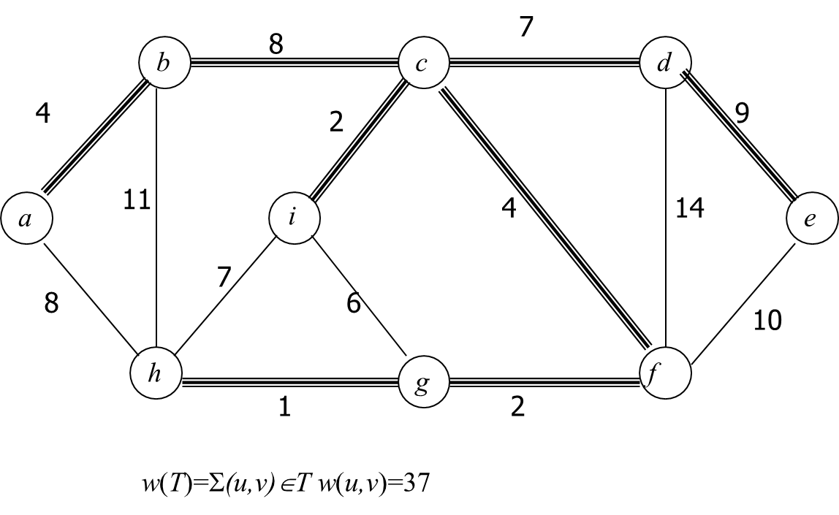
Example

